Slide 1

Telehealth Workshop
Learn how to confidently use telehealth to manage your health care
InterFaith Works of CNY © 2024

Slide 2
Workshop Objectives
Understand what telehealth is with examples
Learn how to use my Patient Portal
Identify best practices for a telehealth visit
InterFaith Works of CNY © 2024

Slide 3
Overview of Modules
“What is Telehealth?”
Walkthrough of an On-Demand Telehealth Visit
Using Your Patient Portal
Best Practices
InterFaith Works of CNY © 2024

Slide 4
Ice-Breaker Activity
What is your goal with our workshop today?
InterFaith Works of CNY © 2024

Slide 5
Module 1. “What is Telehealth?”
Definition, Profiles, Uses, Benefits & “Mythbusters”
InterFaith Works of CNY © 2024

Slide 6
Module Opening Activity
Using Post-It Notes, write a use, definition, or fact about telehealth. We will use these during our “Mythbusters” activity!
InterFaith Works of CNY © 2024
Notes:
Feel free to write more than one, but please use a separate Post-It Note

Slide 7
Defining Telehealth
“Using digital technology to access remote health care services and communicate with your provider about your health.”
InterFaith Works of CNY © 2024
Notes:
“How many of you have used telehealth? For those of you have, use a thumbs up, thumbs down, or medium
For those of you haven’t, let’s hear from 1 or 2 of you as to what has prevented you from using it.”

Slide 8

Profiles of People Who Use Telehealth
“After experiencing an illness that left me unable to drive, I started to use telehealth. Now I’m in the comfort of my own home, relaxed, and speaking with my provider in Brooklyn, NY!”
“I don’t feel comfortable using the internet, but I do have a phone. I used telehealth to have a FaceTime call with my veterinarian!”
“I used telehealth in a moment of crisis after feeling depressed from my caring for my husband with dementia. I have found telehealth to be helpful and a great comfort to me.”
InterFaith Works of CNY © 2024

Slide 9
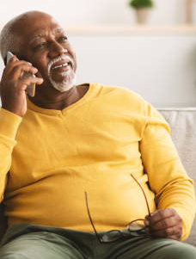
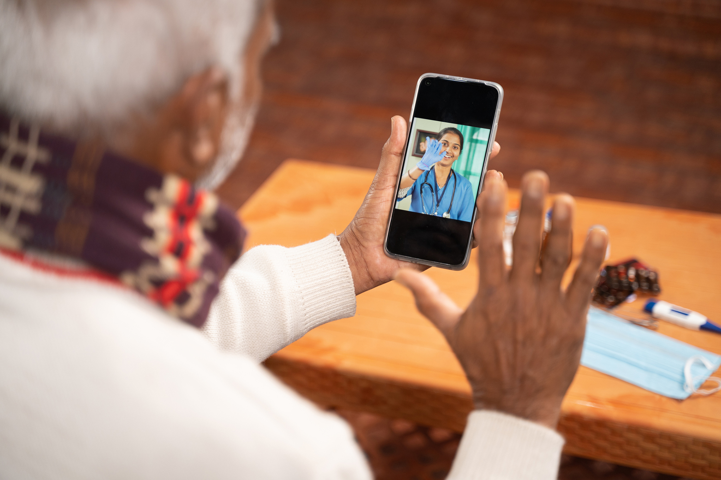
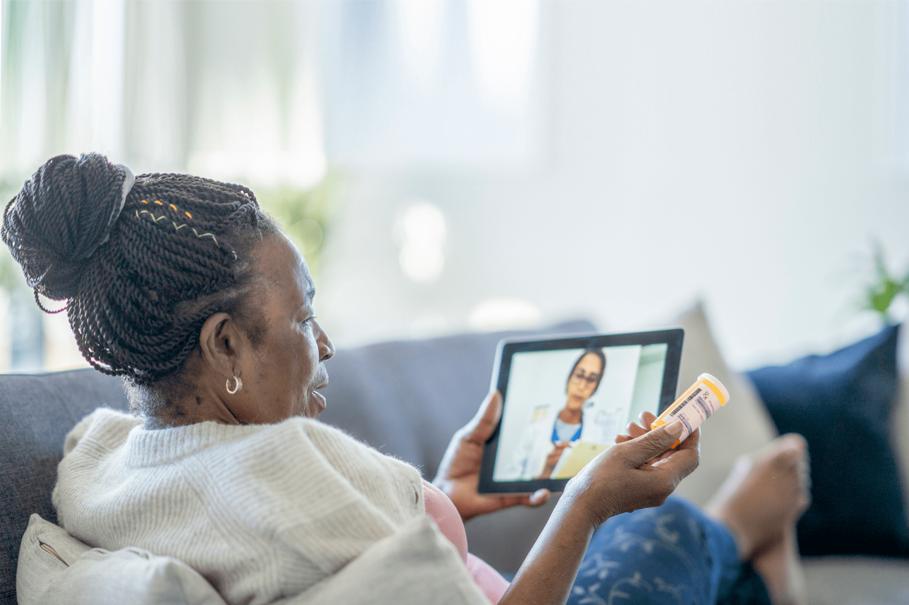
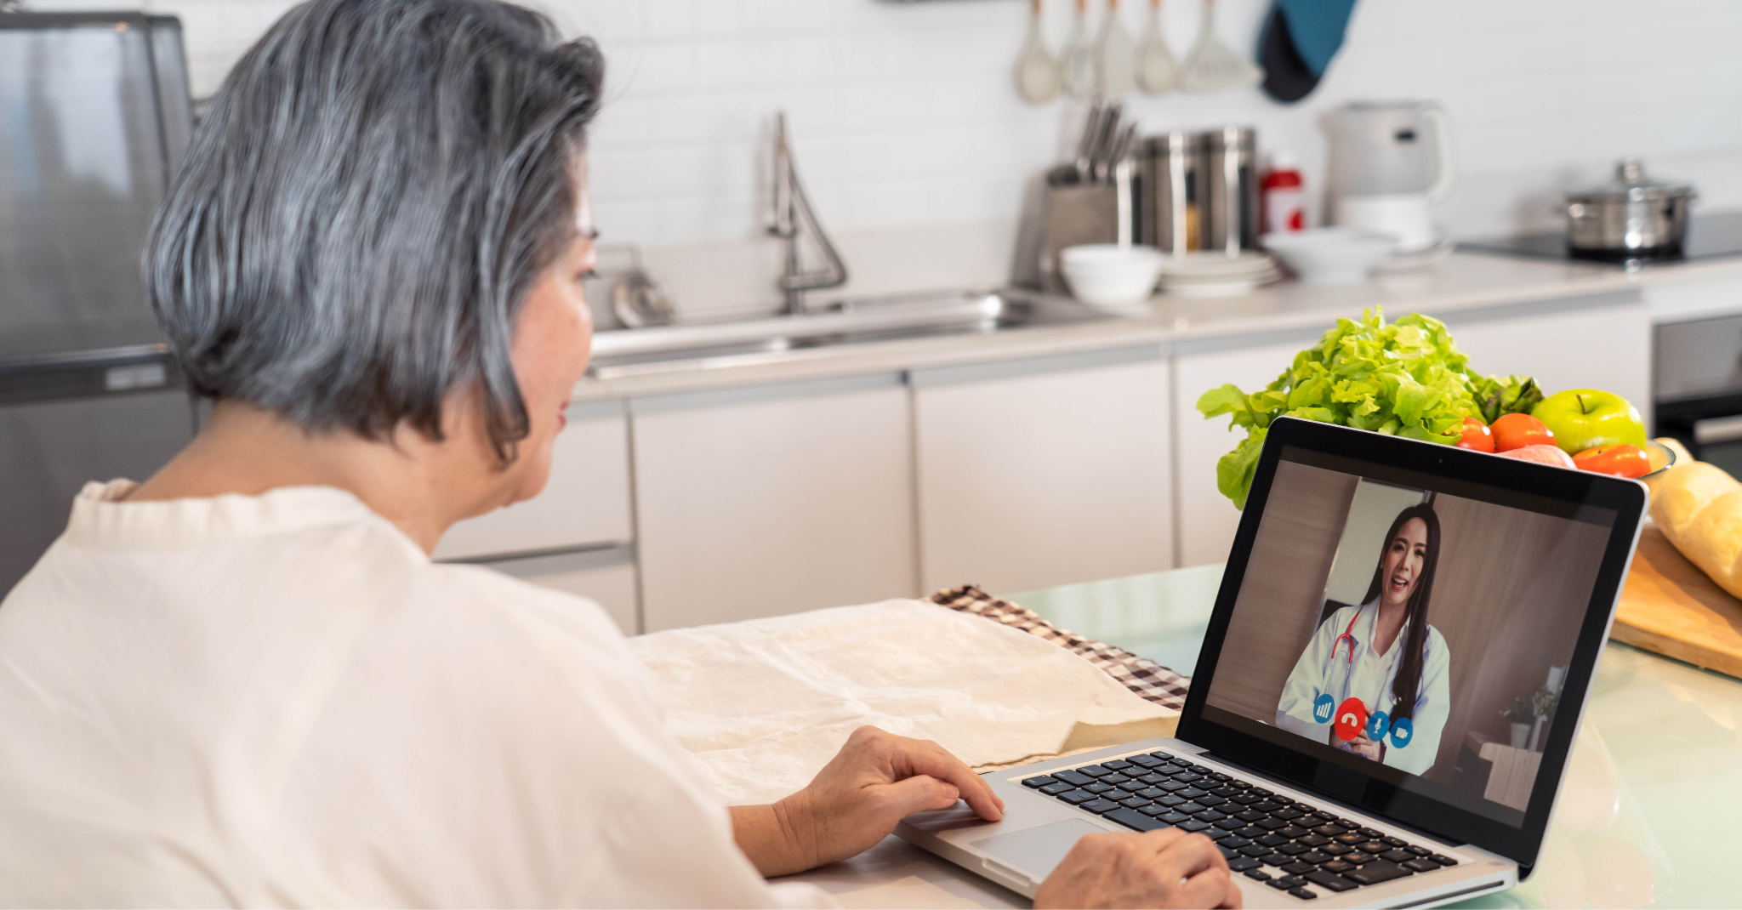
How Can I Access Telehealth?
Voice-Only
Phone
Tablet
Computer
InterFaith Works of CNY © 2024
Notes:
“Which of these devices have you used to access a telehealth visit?”

Slide 10
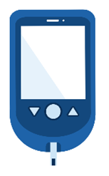
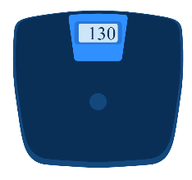
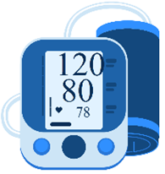
Types of Telehealth
Live Video: Two-way interaction between a patient and provider in real time with video and audio.
Voice-Only: A telehealth visit over the phone with only audio.
Remote Monitoring: Medical data that is collected and sent to the provider electronically (blood pressure, blood sugar, weight).
InterFaith Works of CNY © 2024

Slide 11
How Can I Access A Live Video Telehealth Visit?
It is important that in order to access telehealth you have a(n):
Strong and reliable internet connection
Active email address to receive the telehealth video link
InterFaith Works of CNY © 2024

Slide 12
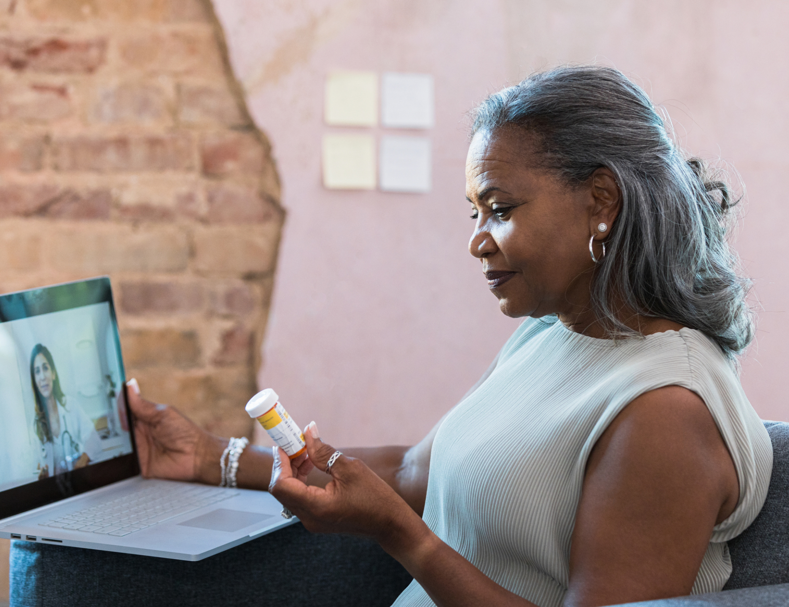
Other Uses for Telehealth
Dermatology (skin care)
General wellness visits
Mental health counseling
Treatment follow-up
Prescription medications
InterFaith Works of CNY © 2024
Notes:
“Has anyone else used telehealth in a way that we have not already discussed?”

Slide 13
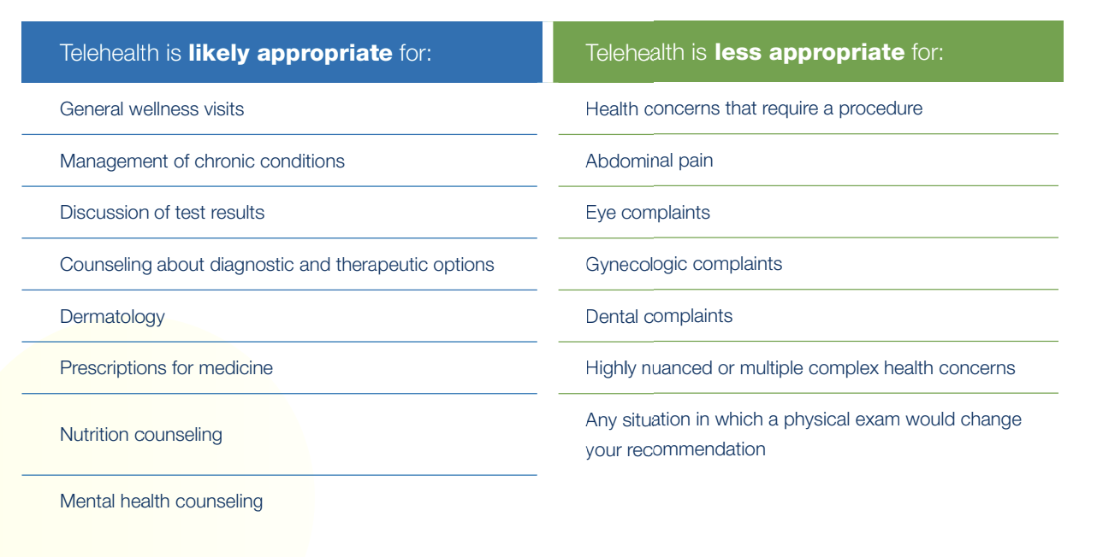
Types of Telehealth
InterFaith Works of CNY © 2024

Slide 14

Benefits of Telehealth
You may prefer telehealth if you…
Have transportation barriers
Have mobility issues
Are immunocompromised
Are an established patient
InterFaith Works of CNY © 2024

Slide 15
Let’s Review our Post-It Notes!
“Mythbusters” Activity
InterFaith Works of CNY © 2024

Slide 16

End-Of Module Check-In
How are you feeling about the content so far?
What is something new that you learned?
InterFaith Works of CNY © 2024

Slide 17
Module 2. On-Demand Telehealth Visit
Watch how to schedule a telehealth visit on MyChart, tips for internet safety
InterFaith Works of CNY © 2024

Slide 18
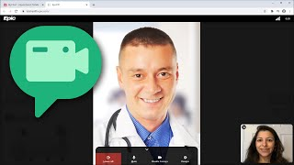
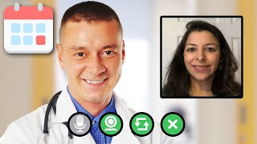
Video: Scheduling a Telehealth Visit in the Patient Portal
Computer
Phone
InterFaith Works of CNY © 2024
Notes:
Computer:https://www.youtube.com/watch?v=NYrck_qhhhs&feature=youtu.be
Phone:https://www.youtube.com/watch?v=BatbilpZqD0

Slide 19

How to Stay Safe Online with Telehealth
Make sure your internet connection is secure
Do not click on any link that you do not trust
You are not required to share your SSN with your provider
InterFaith Works of CNY © 2024

Slide 20
End-Of Module Check-In
What was helpful watching how to schedule a telehealth visit?
What your current internet safety concerns?
InterFaith Works of CNY © 2024

Slide 21
Let’s take a 5-minute break!
We will rejoin shortly
InterFaith Works of CNY © 2024

Slide 22
Module 3. Using Your Patient Portal
Definition, Uses, & Video Walkthrough
InterFaith Works of CNY © 2024

Slide 23
Module Opening Activity
With a show of hands, how many of you use a computer, phone, or tablet on a regular basis? Do you use these devices to access your health information?
InterFaith Works of CNY © 2024

Slide 24
What is a Patient Portal?
“A website where a patient can see their personal health information.​”
Schedule appointments (including telehealth)
View test results
Message with your provider
Request medication refills
InterFaith Works of CNY © 2024

Slide 25
Types of Patient Portals
EHR: Electronic Health Records
MyChart is an Epic patient portal and currently used at:
  SUNY Upstate Hospital
  St. Joseph’s Hospital
Other patient portals will have similar features and layouts
InterFaith Works of CNY © 2024

Slide 26
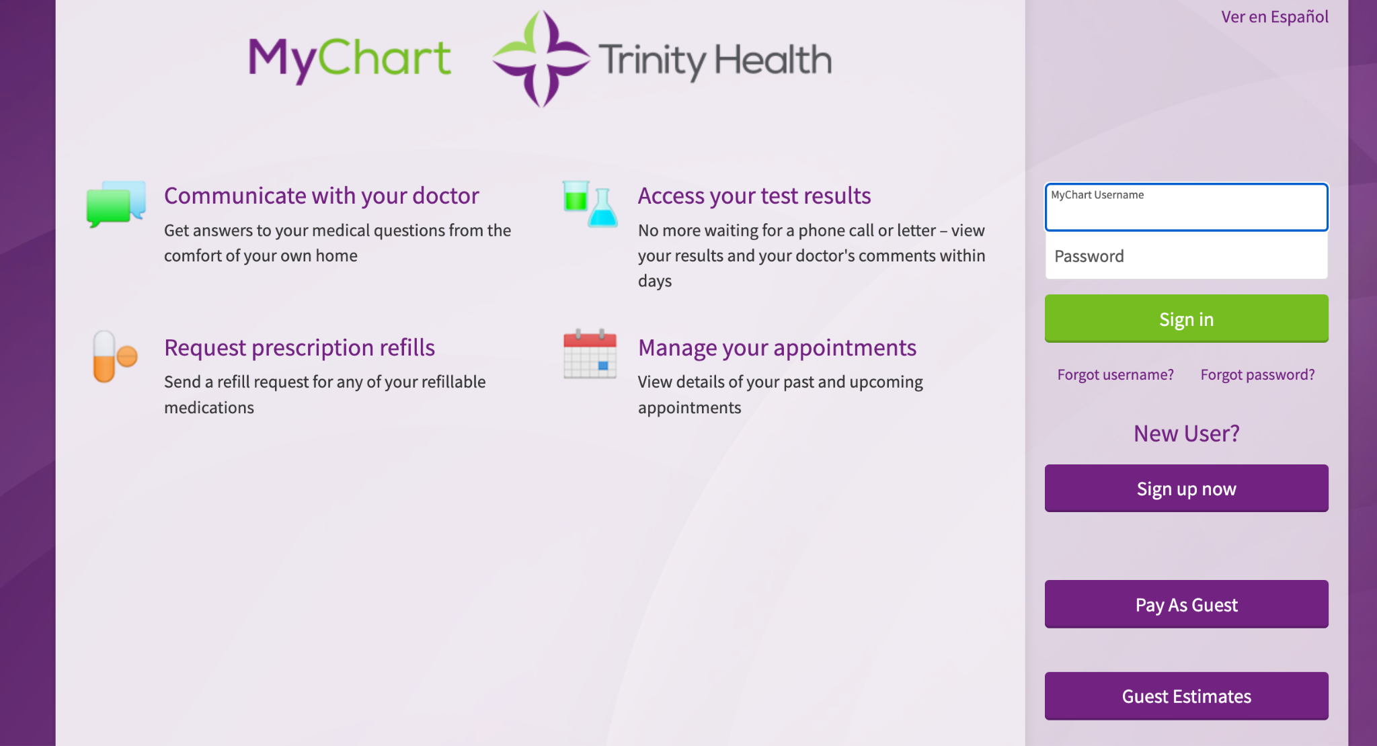
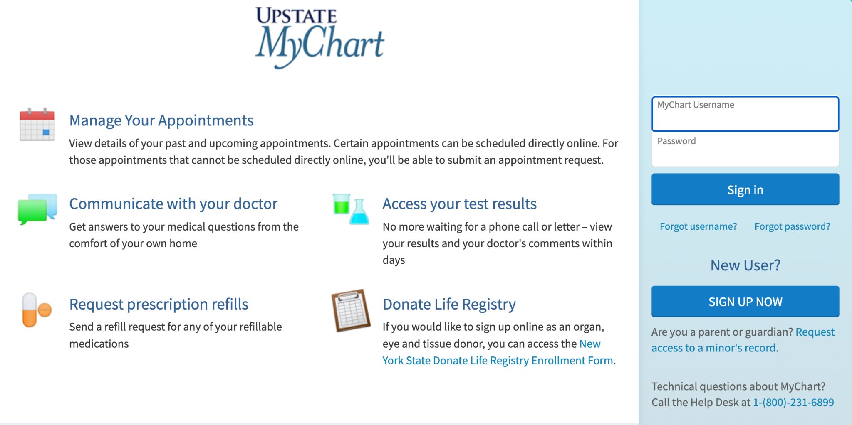
Types of Patient Portals: MyChart
InterFaith Works of CNY © 2024

Slide 27
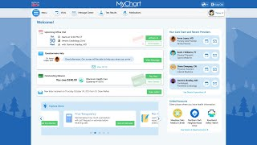
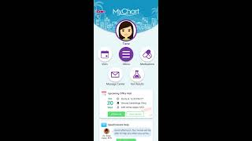
Video: Accessing Your Patient Portal
Computer
Phone
InterFaith Works of CNY © 2024
Notes:
Computer:https://www.youtube.com/watch?v=bmodXZGjGiM
Phone: https://www.youtube.com/watch?v=XQ__9oJsgvA

Slide 28
End-Of Module Check-In
Show of hands, do you see yourself using your Patient Portal?
What is something you learned about the Patient Portal that you are excited to try?
InterFaith Works of CNY © 2024

Slide 29
Module 4. Best Practices
How to get the most out of your telehealth visit
InterFaith Works of CNY © 2024

Slide 30
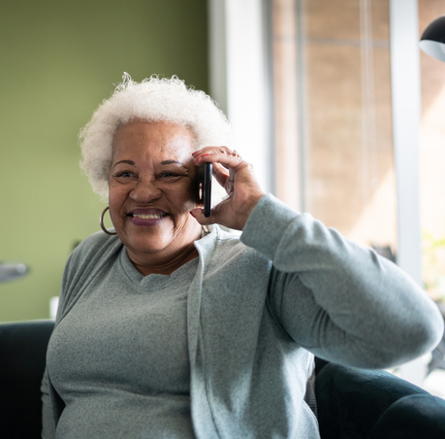
Before Your Telehealth Visit
Practice using important functions (link, video, audio)
Charge your device and find a well-lit, quiet area to have your visit
Prepare any questions
Remember your health information is private!
InterFaith Works of CNY © 2024
Notes:
Practice clinking the telehealth link to see what happens

Slide 31
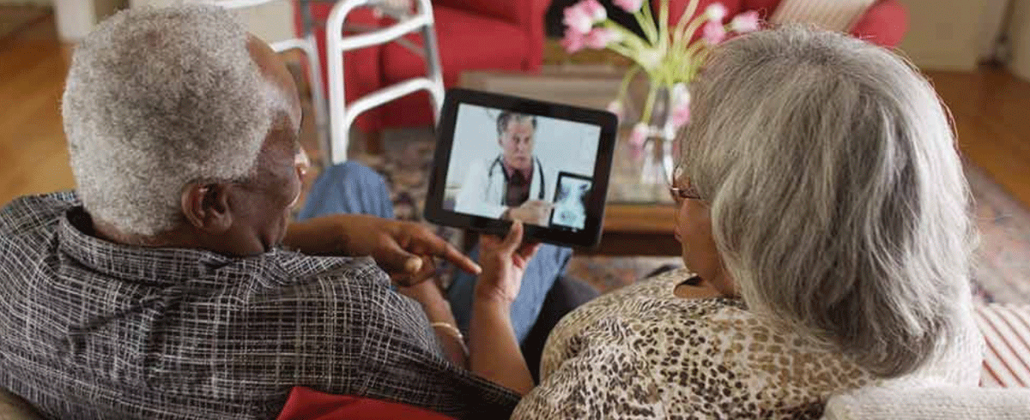
During Your Telehealth Visit
Introduce your aide and/or caregiver
Describe any symptoms
Answer and ask questions
Next steps

Slide 32

After Your Telehealth Visit
Follow any next steps
If you have concerns or are unsure about what to do next, contact your provider through your Patient Portal or call the office
InterFaith Works of CNY © 2024
Notes:
Examples: Tests, physical therapy, changes to diet, referrals, symptoms to watch for, and/or upcoming appointments

Slide 33
End-Of Module Check-In
Which of the Best Practices stuck out to you?
Do you plan to use any of these practices in your next telehealth visit?
InterFaith Works of CNY © 2024

Slide 34
Closing Thoughts
Revisit objectives and discuss next steps
InterFaith Works of CNY © 2024

Slide 35

I want to use telehealth, what’s next?
Ask others to share their experiences with telehealth
Be comfortable with using your device
Reach out to your provider and find out whether telehealth is right for you and your health care
InterFaith Works of CNY © 2024

Slide 36

I am still not ready to use telehealth
What concerns do you still have?
Find an achievable goal in using technology
Be mindful of how illnesses could impact your care in the future
InterFaith Works of CNY © 2024

Slide 37
Workshop Objectives
Understand what telehealth is with examples
Learn how to use my Patient Portal
Identify best practices for a telehealth visit
InterFaith Works of CNY © 2024

Slide 38
About InterFaith Works of CNY
InterFaith Works of CNY’s Mission Statement
InterFaith Works affirms the dignity of each person and every faith tradition, builds racial and religious equity, and creates bridges of understanding among us.
Digital Inclusion Program for Older Adults
Created through the Center for Healthy Aging, the Digital Inclusion Program is dedicated to helping older adults learn to use devices like phones, tablets, and computers to safely enrich their lives.
InterFaith Works of CNY © 2024

Slide 39

Contact InterFaith Works of CNY
Lori Klivak
Senior Director, Center for Healthy Aging
lklivak@ifwcny.org
(315) 449-3552 ext. 109
1010 James St.
Syracuse, NY 13203
InterFaith Works of CNY © 2024
InterFaith Works of CNY © 2024

